Slide 1
Effective HPV Vaccine Recommendations
Shannon Stokley, DrPH
Immunization Services Division
February 14, 2017

Slide 2
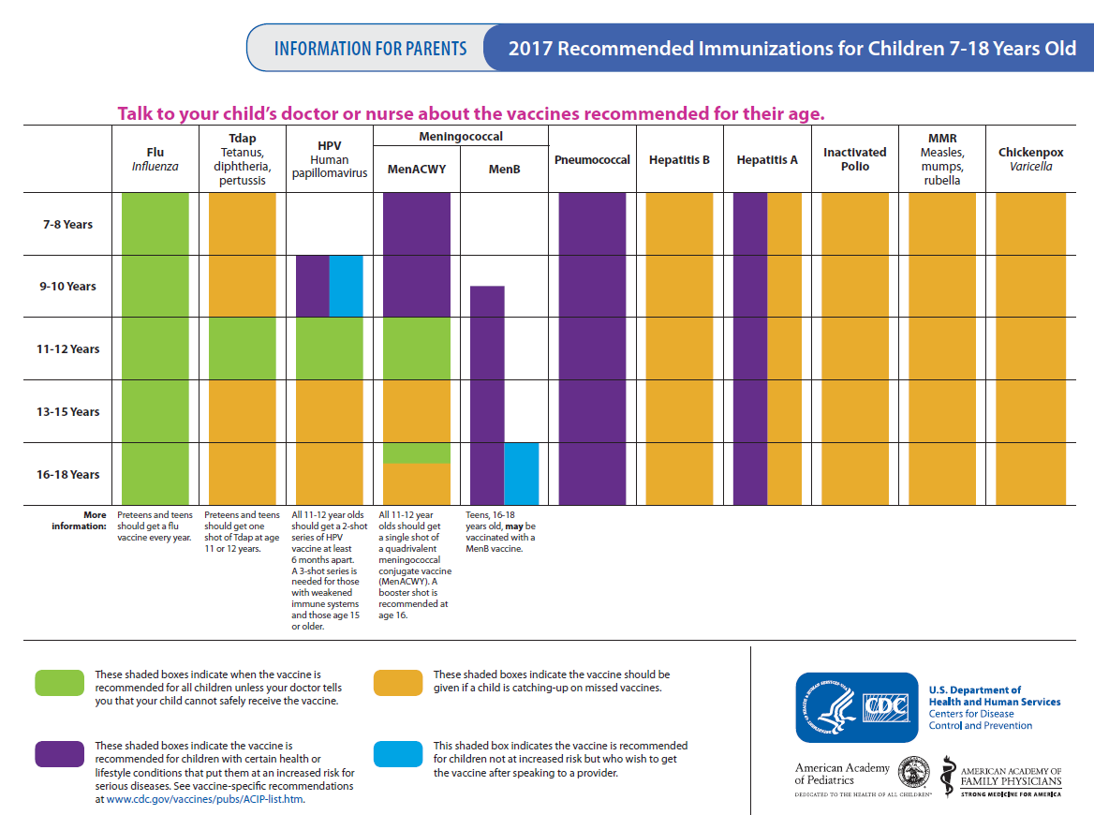

Slide 3
Estimated Vaccination Coverage among Adolescents Aged 13-17 Years, NIS-Teen, United States, 2006-2015
* APD = Adequate provider data
†≥2 doses MenACWY among adolescents aged 17 years
Notes:
From 2006-2015, we’ve seen improvement in adolescent vaccination coverage. However, despite HPV vaccine recommendations for females being published around the same time as those for Tdap and MenACWY, HPV vaccination coverage in females has increased at a comparatively slow pace. The next few slides will focus on HPV vaccination coverage.

Slide 4
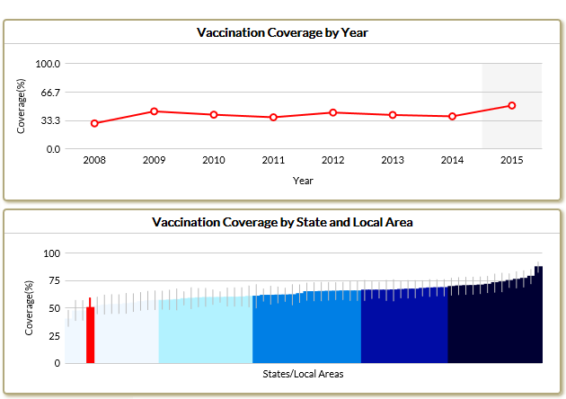
>1 Dose HPV Vaccination among Females 13-17 years of age, Kansas

Slide 5
Reasons parents won’t initiate HPV vaccination for children
Stokley et al. MMWR. 2014.
Notes:
Studies consistently show that a strong recommendation from you is the single best predictor of vaccination for any vaccine, including HPV vaccine. In the 2014 NIS-Teen nearly 15% of parents who said that they would not be getting their child vaccinated against HPV in the next 12 months, stated not receiving a recommendation as one of the top reasons.

Slide 6
Percent of physicians that “Strongly Recommend” HPV vaccine by patient age group --- Female Patients
16-18 years
13-15 years
16-18 years
13-15 years
11-12 years
11-12 years
9-10 years
9-10 years
Pediatrics. 2010;126(3):425-33.
Academic Pediatrics. 2013;13:466-474.
Pediatrics. 2016;137(2):e20152488.

Slide 7
Value Parents Place on the Vaccines
Adapted from Healy et al. Vaccine. 2014.
Notes:
This data is from research with parents regarding immunization for their children. When asked how much value they placed on each of the vaccines, you can see that they ranked these vaccines similarly.

Slide 8
Clinician estimations
Adapted from Healy et al. Vaccine. 2014.
Notes:
In this study providers were asked to estimate how much value parents placed on the same vaccines. As you can see, they guessed correctly for vaccines protecting against meningitis, hepatitis, pertussis.

Slide 9
Clinicians underestimate the value parents place on HPV vaccine
Adapted from Healy et al. Vaccine. 2014.
Notes:
However, the estimates that clinicians gave for how much value parents place on flu and HPV vaccination are much lower. These clinicians underestimated the value parents place on HPV vaccine. This is evidence of a big disconnect between parents and clinicians.

Slide 10
“The perceived and real concerns of parents influence how the clinician recommends and administers HPV vaccine.”
Adapted from Healy et al. Vaccine. 2014.
Notes:
Whether a parents concerns are real or just perceived by the clinician, it affects the way HPV vaccine is recommended and administered. This changes the conversation between the clinician and the parents regarding HPV vaccine.

Slide 11
What is an
EFFECTIVE
recommendation
for HPV vaccination?
Notes:
So that begs the question. What IS an effective recommendation for HPV vaccination?

Slide 12
Same Way
Same Day
Notes:
The best and most effective recommendation for HPV vaccination is when HPV vaccine is recommended in the same way and on the same day as the other vaccines recommended for girls and boys at ages 11 and 12 years.

Slide 13
Make an Effective Recommendation
  Same way: Effective recommendations group all of the adolescent vaccines
  Recommend HPV vaccination the same way you recommend Tdap & meningococcal vaccines.
Same day: Recommend HPV vaccine today
Recommend HPV vaccination the same day you recommend Tdap & meningococcal vaccines.
Brewer at al. Pediatrics. 2017. Unpublished CDC data, 2013.
Notes:
Successful recommendations group all of the adolescent vaccines
Recommend the HPV vaccine series the same way you recommend the other adolescent vaccines

Slide 14
Tdap
HPV
MenACWY
Preteen Vaccines
Notes:
We call this the “bundled recommendation” because it bundles all of the vaccines recommended for preteens into one effective and presumptive statement.

Slide 15
Announcement vs. Conversation
Will a “conversation” versus an “announcement” of vaccines recommended on the adolescent platform impact uptake?
Brewer NT, Hall ME, Malo TL, et al. Announcements Versus Conversations to Improve HPV Vaccination Coverage: A Randomized Trial. Pediatrics. 2017;139(1):e20161764

Slide 16
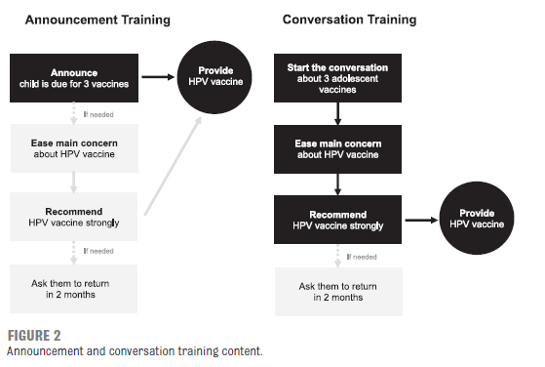
Announcement vs. Conversation

Slide 17
Structure of “announcement”
Child is due for 3 vaccines to be given today:
  mentioning the child’s age;
  announcing the child is due for 3 vaccines recommended for children this age,
  placing HPV vaccine in the middle of list; and
  Saying they will vaccinate today
Brewer NT, Hall ME, Malo TL, et al. Announcements Versus Conversations to Improve HPV Vaccination Coverage: A Randomized Trial. Pediatrics. 2017;139(1):e20161764

Slide 18
Example: Announcement
Note child’s age
“I see here that Michael just turned 11”
Announce the child is due for 3 vaccines recommended for children this age, place HPV vaccine in middle of list
“Because he’s 11, Michael is due for meningitis, HPV, and Tdap vaccines”
Say you will vaccinate today
“We’ll give those at the end of today’s visit”
Move on with the visit
Brewer NT, Hall ME, Malo TL, et al. Announcements Versus Conversations to Improve HPV Vaccination Coverage: A Randomized Trial. Pediatrics. 2017;139(1):e20161764

Slide 19
Example: Conversation
Introduce 3 vaccines recommended for children this age, place HPV vaccine in middle of list
“There are three important vaccines we give to kids Michael’s age – meningitis, HPV, and Tdap”
Discuss health benefits
“We give these vaccines now to prevent infections that can cause serious health problems in adolescence and adulthood. Because the vaccines are preventive, they’re important to get well before exposure.”
Invite questions, saving recommendation for later
“What questions do you have?”
Brewer NT, Hall ME, Malo TL, et al. Announcements Versus Conversations to Improve HPV Vaccination Coverage: A Randomized Trial. Pediatrics. 2017;139(1):e20161764

Slide 20
“Announcement” improved HPV vaccine acceptance, compared to “conversation”
Brewer NT, Hall ME, Malo TL, et al. Announcements Versus Conversations to Improve HPV Vaccination Coverage: A Randomized Trial. Pediatrics. 2017;139(1):e20161764

Slide 21
Some Parents Need Reassurance
Many parents simply accept this bundled recommendation
Some parents may be interested in vaccinating, yet still have questions. Interpret a question as
they need additional reassurance from YOU,
the clinician they trust with their child’s health care
Ask parents about their main concern
(be sure you are addressing their real concern)
Unpublished CDC data, 2013.
Notes:
Most parents will accept the bundled recommendation without any questions. Other parents may be interested in vaccinating, yet still have questions
A question from a parents about HPV vaccine does not mean they are refusing or delaying. Many parents with questions about HPV vaccine are looking for additional reassurance from you. Taking the time to listen to parents’ questions helps you save time and give an effective response. Be sure to verify that you are addressing the right concern.

Slide 22
If a parent doesn’t say yes…
Ask | Clarify & restate their concerns to make sure you understand.
Acknowledge | Emphasize it is the parents’ decision. Acknowledge risks & conflicting info sources. Applaud them for wanting what is best for their child. Be clear that you are concerned for the health of their child, not just public health safety.
Advise | Clarify their concerns: make sure you understand & are answering the question they actually care about. Allow time to discuss the pros & cons of vaccines. Be willing to discuss parents’ ideas. Offer written resources for parents. Tailor your advice using this presentation.
Adapted from Henrickson Vax Northwest 2014.
Notes:
A few parents will be hesitant. Here’s a detailed approach to the hesitant parent, based on childhood vaccination work by Vax Northwest.
The steps include: Ask, Acknowledge, & Advise. In short…
-Ask about their concern
-Acknowledge that you know they want to keep their child safe and healthy in every way….and so do you.
-And then advise them on why you recommend getting HPV vaccination now.

Slide 23
If a parent declines…
Declination is not final. The conversation can be revisited.
End the conversation with at least 1 action you both agree on.
Because waiting to vaccinate is the risky choice, many pediatricians ask the parent to sign a Declination Form.
Notes:
Some parents will not accept your recommendation for their child this year. But that doesn’t mean they won’t ever have their child protected with HPV vaccination. Make sure you leave the door open to revisit the conversation at the following annual visit.

Slide 24
1. Know your coverage rates
How to increase the number of target patients who come in & leave vaccinated
AFIX visits for VFC providers
Data from EHR
Ordering data

Slide 25
2. Align office policy with mission
How to increase the number of target patients who come in & leave vaccinated
Immunize at every opportunity
Standing orders
Prompt the person who is supposed to order the vaccine
Reminders
Recalls

Slide 26
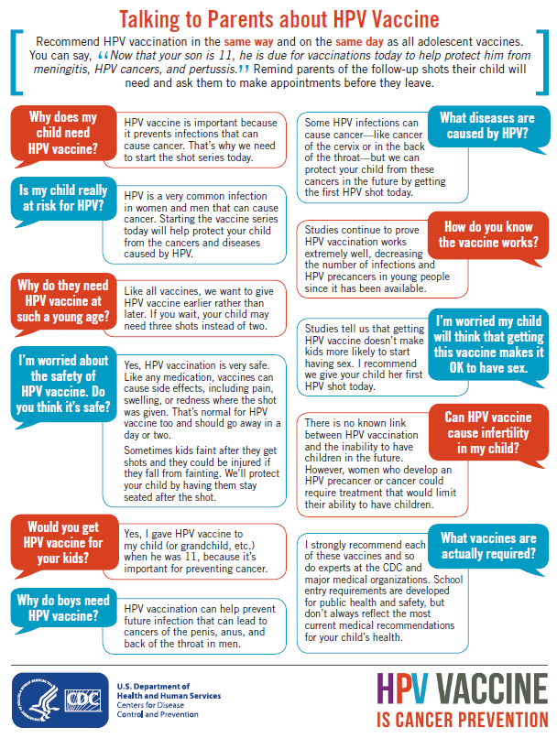
3. Align communication with mission
How to increase the number of target patients who come in & leave vaccinated
EVERYONE in the office needs to be saying the same thing
Share talking points
http://go.usa.gov/x9MQy
Notes:
Make sure that all clinic staff, including those answering the phone and making appointments, are communicating the same way about HPV vaccine. Put the focus on cancer prevention and provide talking points for the staff. One way to be sure that staff have the information that they need is to share with them the tip sheet “Addressing Parents’ Top Questions about HPV Vaccine.”

Slide 27
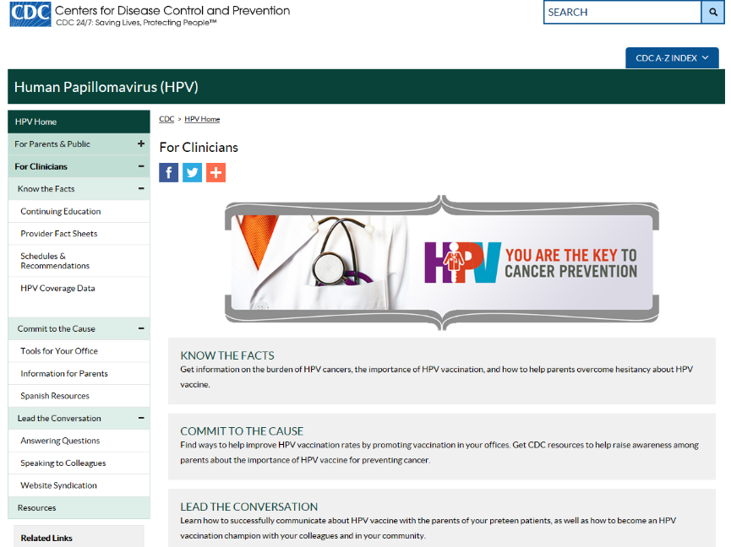
www.cdc.gov/hpv
Notes:
CDC has a variety of resources available to assist clinicians in communicating about HPV vaccine and improving practice to increase immunization rates. Visit CDC.gov slash HPV and click on the section for clinicians.

Slide 28
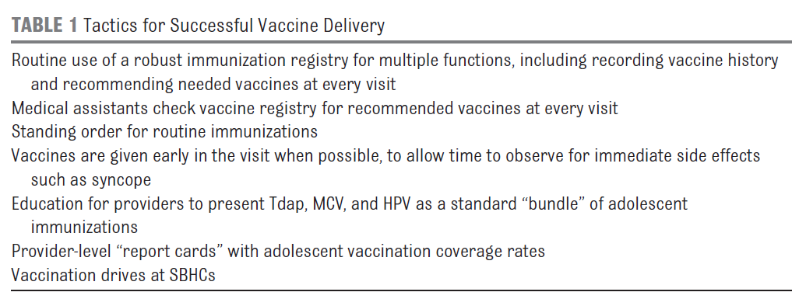
Denver Health Study
Farmer, et al. Achieving high adolescent vaccination coverage. Pediatrics. 2016;138:e20152653

Slide 29
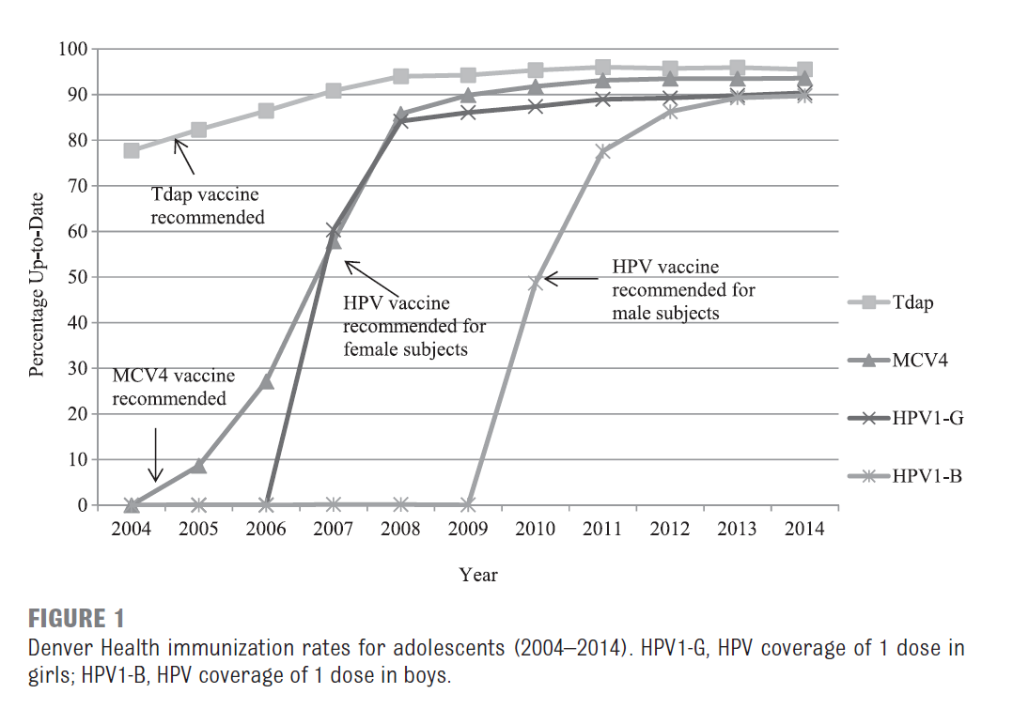
Farmer, et al. Achieving high adolescent vaccination coverage. Pediatrics. 2016;138:e20152653

Slide 30
Thank You!

