Slide 1




Preventing Flu

Slide 2

Overview
Lesson 1: The Burden of Flu
Lesson 2: “Why I want you to be vaccinated”
Lesson 3: How well protected is the Kansas Community?
  Section A
  Section B
Lesson 4: Start with a more effective recommendation
Lesson 5: Quick answers to common family and provider questions
Lesson 6: Beyond Communication: doing better!
Lesson 7: Wrap Up
  Resources
  Getting CE Credit
  #KansasFightsFlu

Slide 3
Lesson 1:
The Burden of Flu

Slide 4
Is it a Cold or Flu?
Signs and Symptoms | Cold | Flu
Symptom Onset | Gradual | Abrupt
Fever | Rare | Usual
Aches | Slight | Usual
Chills | Uncommon | Fairly Common
Fatigue, weakness | Sometimes | Usual
Sneezing | Common | Sometimes
Chest discomfort, cough | Mild to moderate | Common
Stuffy nose | Common | Sometimes
Sore throat | Common | Sometimes
Headache | Rare | Common
Reference: https://www.cdc.gov/flu/about/coldflu.html

Slide 5

Test Your Knowledge!
Fever is more common with _____
Sneezing is more common with _____
An abrupt onset is more common with _____
A gradual onset is more common with _____
A stuffy nose is more common with _____
Aches and headache are more common with _____

Slide 6
Test Your Knowledge!
Fever is more common with flu
Sneezing is more common with a cold
An abrupt onset is more common with flu
A gradual onset is more common with a cold
A stuffy nose is more common with a cold
Aches and headache are more common with flu

Slide 7
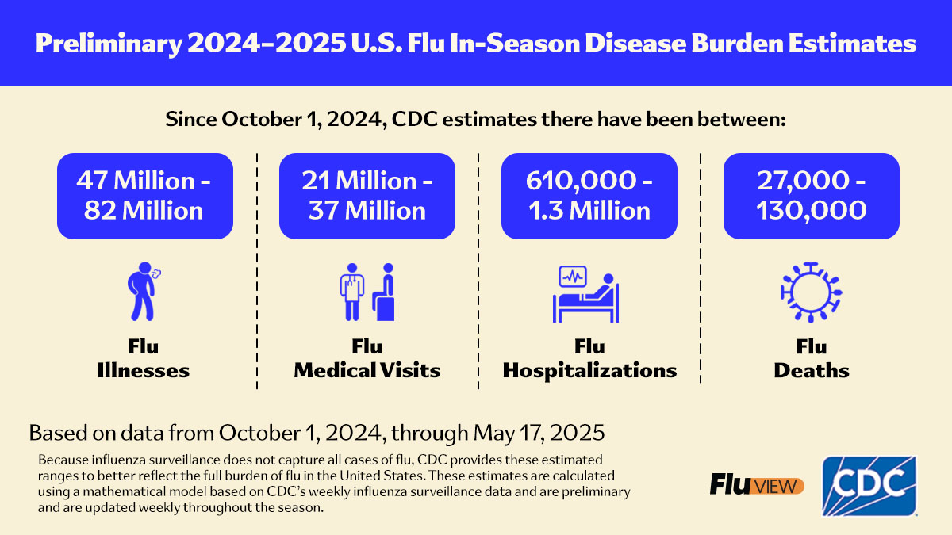
The Burden of Flu
In a single year in the U.S., the burden of influenza is huge.
Let’s take a look at the previous flu season from October 1, 2024, to
May 17, 2025
Reference: www.cdc.gov/flu-burden/php/data-vis/2024-2025.html

Slide 8
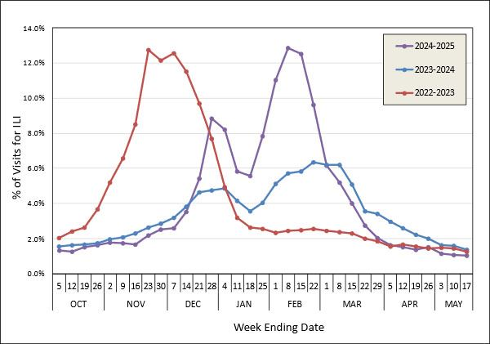
Was Kansas hit this hard?
Yes! In the 2024 – 2025 flu season, flu was a related cause of death for 225 people.
During the worst weeks of the 2024-2025 flu season, more than 13% of Emergency Department visits in Kansas were associated with influenza-like illness.
Reference:
www.kdhe.ks.gov/1476/Influenza-Surveillance

Slide 9
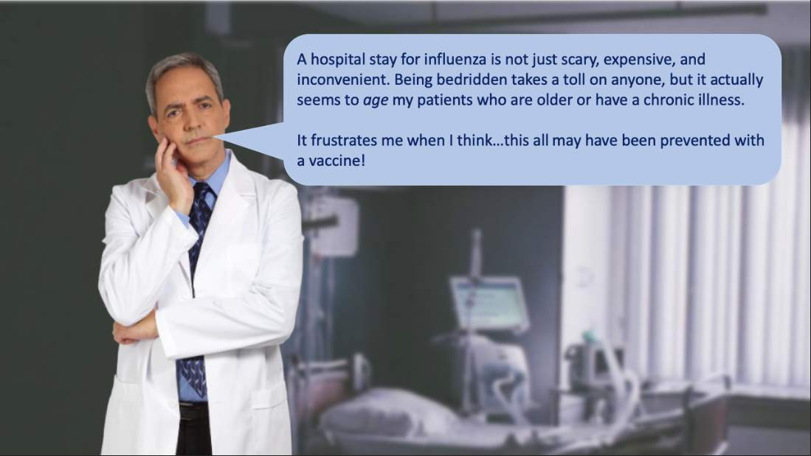

Slide 10
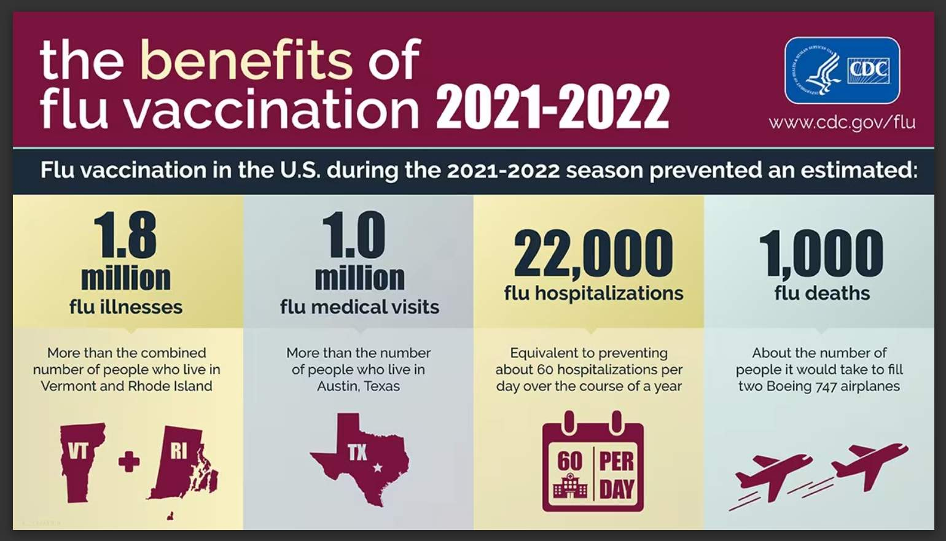
Reference: https://archive.cdc.gov/www_cdc_gov/flu/resource-center/freeresources/graphics/flu-vaccine-protected-infographic.htm

Slide 11
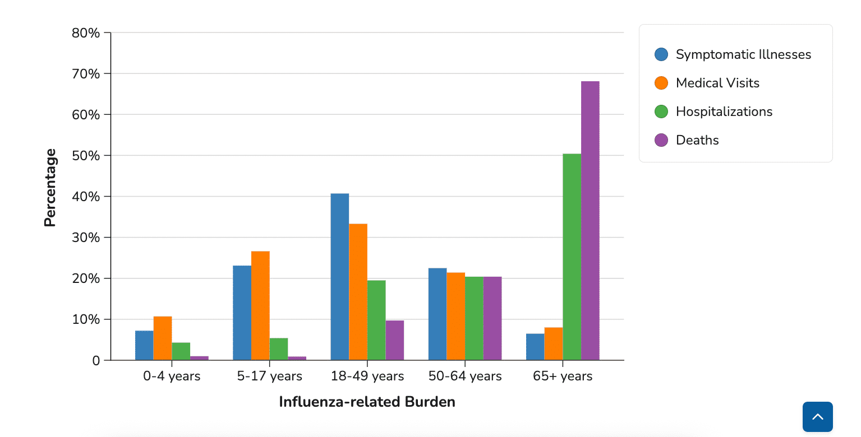
Who should be reminded to get the flu vaccine?
The table below shows the estimated rates of influenza-associated disease outcomes, per 100,000 people in that age group, in the U.S. for the 2023-2024 influenza season.
Reference: https://archive.cdc.gov/#/details?url=https://www.cdc.gov/flu-burden/php/data-vis/2023-2024.html

Slide 12
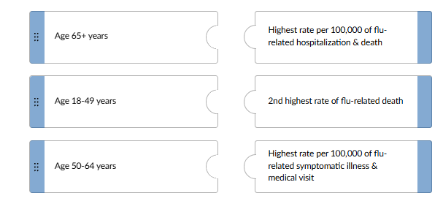
Test Your Knowledge!
Try to match each age-group with its correct description

Slide 13
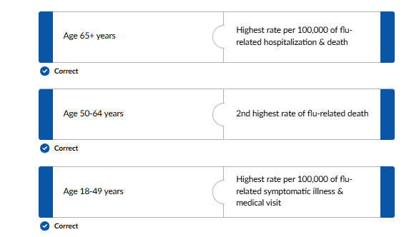

Test Your Knowledge!

Slide 14

Scarlett’s Story
If statistics don't move you, these
stories will.
Families Fighting Flu is a national, nonprofit, advocacy organization dedicated to protecting children, families, and communities against the flu.
They offer a web page with emotional stories of families whose lives have been permanently altered by the flu.
Anyone who isn't impressed with how bad influenza is should watch the heart-wrenching story below.
More family stories can be found at the website of Families Fighting Flu: https://www.familiesfightingflu.org/family-stories/

Slide 15
What we’ve learned so far…
Flu is more severe than common cold
Even if you don’t care about getting the flu yourself, it’s worth getting the vaccine so you don’t spread flu to your parents, grandparents, babies, and grandbabies!
Flu carries with it an enormous burden of illness, hospitalization, and death year after year
The people at greatest risk for flu-related hospitalization are seniors. People aged 50-64 and young children are also at notable risk.
In short… the flu is one bad bug!

Slide 16
Lesson 2:
“Why I want you to be vaccinated”
Patients need to know why you are recommending the flu vaccine for them.
The following lesson contains four key concepts about the flu vaccine:

Slide 17

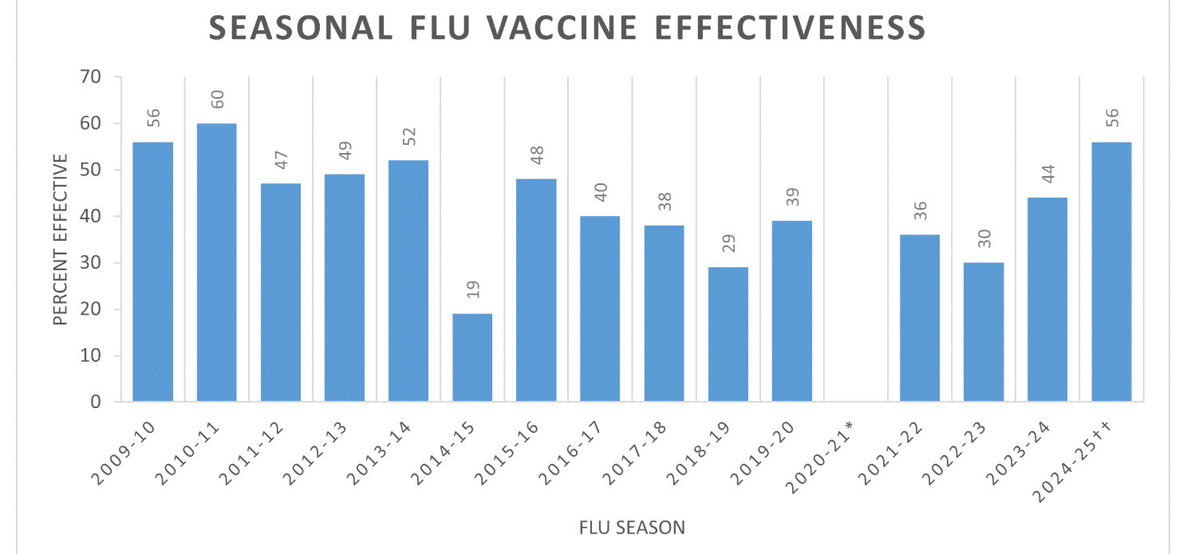
Flu vaccine's effectiveness varies from year to year. This depends largely on two factors:
  Characteristics of the person being vaccinated (e.g., age).
  The “match” between the flu viruses spreading in the community and the flu viruses the flu vaccine is designed to protect against.
You can say to patients:
Usually, flu vaccine reduces the risk of having to go to the doctor with flu by 40-60%.
References:
www.cdc.gov/flu-vaccines-work/benefits/?CDC_AAref_Val
www.cdc.gov/flu-vaccines-work/php/effectiveness-studies/?CDC_AAref_Val

Slide 18

Flu vaccine reduces the severity of flu.
Even though the flu vaccines are imperfect and the uptake is not optimal, the benefit of the flu vaccine is still great.
This is demonstrated by the number of illnesses, hospitalizations, and deaths prevented by influenza vaccine during the 2024-2025 flu season.
You can say to patients:
Although some vaccinated people still get flu symptoms, your risk of severe illness requiring a doctor's visit, hospital stay, or treatment in intensive care is much less if you get the vaccine.
References:
Frutos, et al. Interim Estimates of 2024–2025 Seasonal Influenza Vaccine Effectiveness — Four Vaccine Effectiveness Networks, United States, October 2024–February 2025 https://www.cdc.gov/mmwr/volumes/74/wr/pdfs/mm7406a2-H.pdf
Rondy, et al. Effectiveness of influenza vaccines in preventing severe influenza illness among adults: A systematic review and meta-analysis of test-negative design case-control studies https://www.ncbi.nlm.nih.gov/pubmed/28935236
Rolfes, et al. Effects of influenza vaccination in the United States during the 2017–2018 influenza season https://doi.org/10.1093/cid/ciz075

Slide 19


The flu virus is easy to spread.
Some otherwise healthy adults infected with the flu virus may be able to infect others 1 day before symptoms develop and up to 7 days after becoming sick.
The virus can spread in mucus droplets when an infected person talks, coughs, or sneezes and these droplets spread to others up to about 6 feet away.
You can say to patients:
Even if you’re not worried about getting the flu yourself, the flu vaccine is worth getting because you don’t want to spread the flu to your loved ones. You don’t want to be responsible for getting them sick!
Reference: https://www.cdc.gov/flu/about/disease/spread.htm
Image by Gordon Johnson from Pixabay

Slide 20

Side effects from flu vaccination are generally mild (e.g., soreness, fever) especially when compared to symptoms of flu disease.
Providers should be aware of the possibility of:
Young children who receive inactivated flu vaccine and pneumococcal vaccine at the same visit may be at increased risk for a febrile seizure
Vaccination (or other injections) may lead to fainting, which can lead to injury. To prevent this, many offices have patients stay seated for 15 minutes after vaccination.
Shoulder Injury Related to Vaccine Administration (SIRVA) occurs when an intramuscular deltoid injection is administered into the shoulder joint.
Severe allergic reactions from a vaccine are very rare (<1 in a million doses). If it were to occur, it would usually be within a few minutes to a few hours after vaccination.
You can say to patients:
Flu vaccines are safe. Hundreds of millions of Americans have safely received seasonal flu vaccines and there has been extensive research supporting flu vaccine safety.
Reference: https://www.cdc.gov/vaccine-safety/vaccines/flu.html

Slide 21
There are several reasons why people continue to think the flu vaccine caused the flu.
Take a guess…
Which statements are true?
People who receive a flu shot may have muscle soreness and low-grade fever after vaccination, but this is not influenza.
You may develop flu if exposed to the virus before protective immunity develops 1-2 weeks after vaccination.
Influenza vaccine only protects against certain influenza viruses, not all viruses. You may develop a cough and fever because of another virus.
Influenza vaccine is not 100% effective, especially in older persons.

Slide 22

Take a guess…
Which statements are true?
People who receive a flu shot may have muscle soreness and low-grade fever after vaccination, but this is not influenza.
You may develop flu if exposed to the virus before protective immunity develops 1-2 weeks after vaccination.
Influenza vaccine only protects against certain influenza viruses, not all viruses. You may develop a cough and fever because of another virus.
Influenza vaccine is not 100% effective, especially in older persons.

Slide 23
Take a guess…
Which statements are true?
People who receive a flu shot may have muscle soreness and low-grade fever after vaccination, but this is not influenza.
Correct!
All four of these statements are true.
For more details, see Immunize.org’s
‘Ask the Experts’ webpage on influenza.
You may develop flu if exposed to the virus before protective immunity develops 1-2 weeks after vaccination.
Influenza vaccine only protects against certain influenza viruses, not all viruses. You may develop a cough and fever because of another virus.
Influenza vaccine is not 100% effective, especially in older persons.

Slide 24
Lesson 3:
How Well Protected is the Kansas Community?

Slide 25
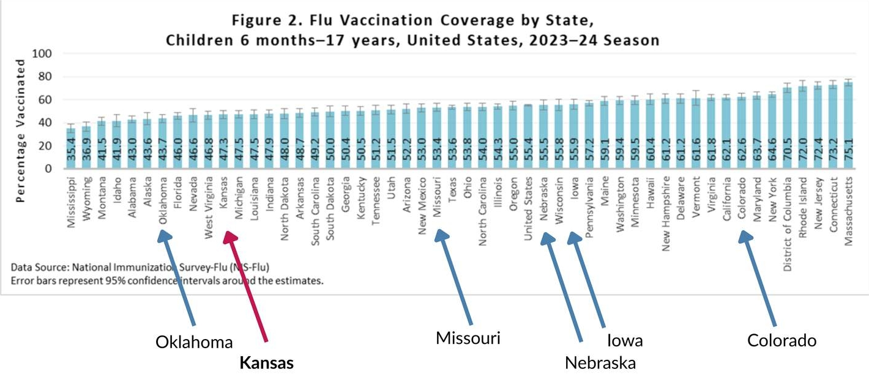
Section A. Flu Vaccination Coverage by Age
A1. Flu Vaccination Coverage - Children
Looking at the graph above, we see that in the 2023-24 influenza season, flu vaccine coverage among children 6 months - 17 years of age was higher in Kansas than in Oklahoma, but lower than in Missouri, Nebraska, Iowa, or Colorado.
U.S. flu vaccination coverage for children (6 months to 17 years)
www.cdc.gov/fluvaxview/coverage-by-season/2023-2024.html#cdc_report_pub_study_section_3-results

Slide 26
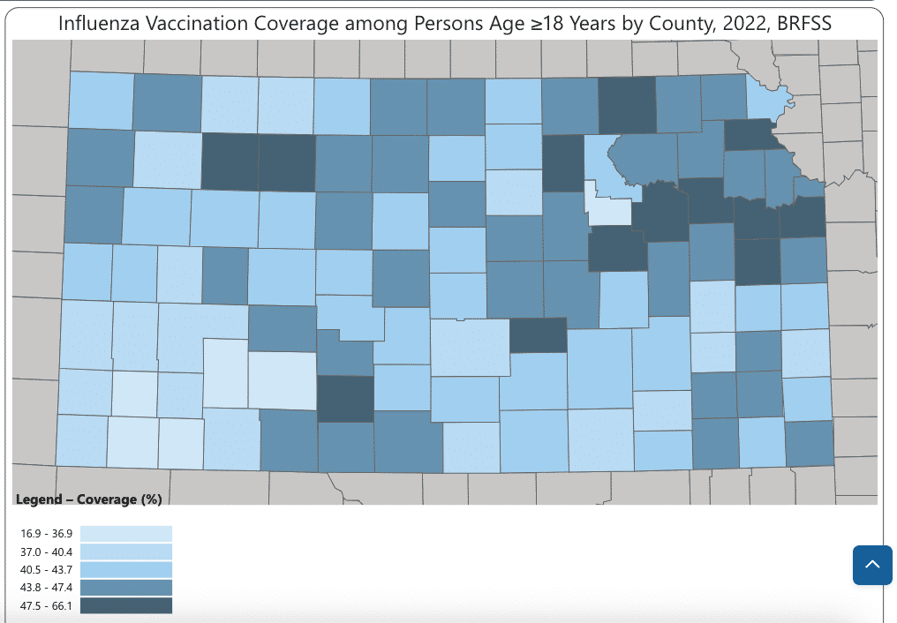
A2. Flu Vaccination Coverage - Adults
Kansas county level data on adult vaccination coverage
www.cdc.gov/fluvaxview/interactive/general-population-coverage.html

Slide 27
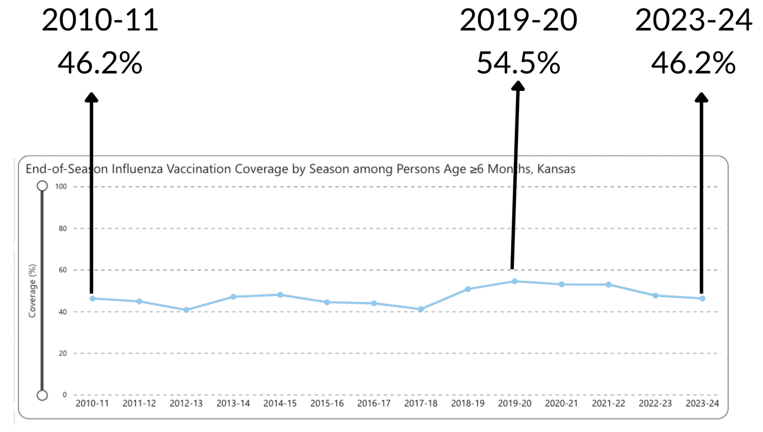
A3. Flu Vaccination Coverage – Children & Adults
Influenza vaccination coverage by season among people at least 6 months of age
www.cdc.gov/fluvaxview/interactive/general-population-coverage.html

Slide 28
Take a guess…
Which statements are true?
In the line graph above, we see improvement from 46.2% to 54.5% (+ 8.3%) from 2010-2011 to 2019-2020 in coverage for persons at least 6 months of age. Then, coverage fell back to 46.2%.
In the 2023-2024 season, childhood flu vaccine coverage for Kansas was among the highest of all the states
Kansas has a tremendous opportunity for improvement of its flu vaccine coverage

Slide 29


Take a guess…
Which statements are true?
In the line graph above, we see improvement from 46.2% to 54.5% (+ 8.3%) from 2010-2011 to 2019-2020 in coverage for persons at least 6 months of age. Then, coverage fell back to 46.2%.
In the 2023-2024 season, childhood flu vaccine coverage for Kansas was among the highest of all the states
Kansas has a tremendous opportunity for improvement of its flu vaccine coverage

Slide 30
Take a guess…
Which statements are true?
True.
2. In the 2023-2024 season, childhood flu vaccine coverage for Kansas was #11 from the lowest, not among the highest.
3. True! For children and adults, we can protect more people from flu!
In the line graph above, we see improvement from 46.2% to 54.5% (+ 8.3%) from 2010-2011 to 2019-2020 in coverage for persons at least 6 months of age. Then, coverage fell back to 46.2%.
In the 2023-2024 season, childhood flu vaccine coverage for Kansas was among the highest of all the states
Kansas has a tremendous opportunity for improvement of its flu vaccine coverage

Slide 31
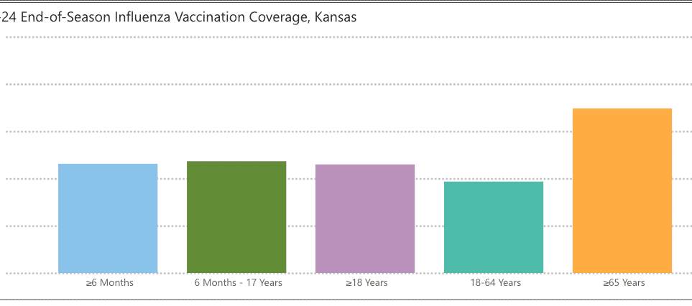
Section B. Flu Vaccination Coverage by Age, Race, and during Pregnancy
B1. Flu Vaccination Coverage – Age Groups
There are large differences in flu vaccination coverage by age group as shown below
Persons > 6 months (i.e., all eligible ages, including older adults
www.cdc.gov/fluvaxview/interactive/general-population-coverage.html

Slide 32
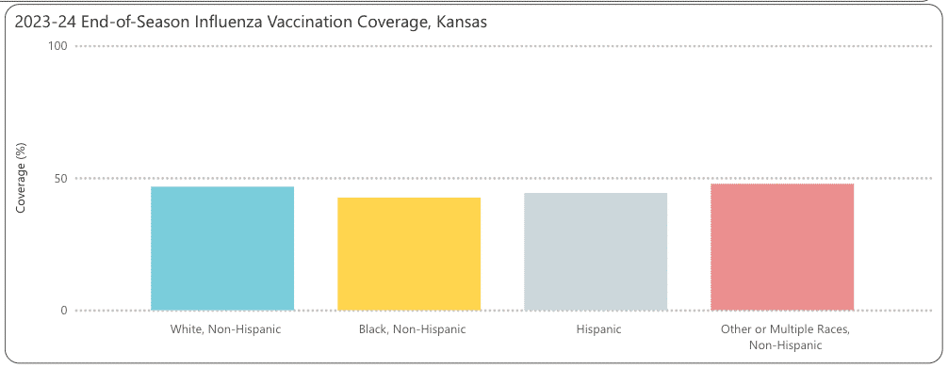
B2. Flu Vaccination Coverage – Race & Ethnicity
In Kansas there are also differences in flu vaccination coverage by race and ethnicity, although these are not statistically significant.
White-NH 46.7%, Black-NH 42.6, Hispanic 44.3%, Other-NH 47.8%
Note: These data by race and ethnicity are confounded by economic status.
www.cdc.gov/fluvaxview/interactive/general-population-coverage.html

Slide 33

B3. Flu Vaccination Coverage – During Pregnancy
Since 1997 ACIP has recommended vaccinating pregnant women against flu for two reasons:
To protect the pregnant woman – Pregnant women are at increased risk for complications, hospitalization, and death from influenza.
To protect the newborn – Babies cannot get the flu vaccine until 6 months of age. When a pregnant woman gets a flu shot, the protective antibodies made in her body cross the placenta to her baby. These antibodies will protect her baby against the flu until she/he can get the vaccine at 6 months of age.
The flu vaccine can be given in any trimester.
The flu vaccine is safe during pregnancy
The American College of Obstetricians and Gynecologists states that flu vaccines “have been used for many years in millions of pregnant women and are not known to cause pregnancy problems or birth defects.”
Reference: https://www.acog.org/patient-resources/faqs/pregnancy/the-flu-vaccine-and-pregnancy

Slide 34


Take a guess…
In Kansas in the most recent season with available data (2022), what proportion of pregnant women received the flu vaccine?

Slide 35
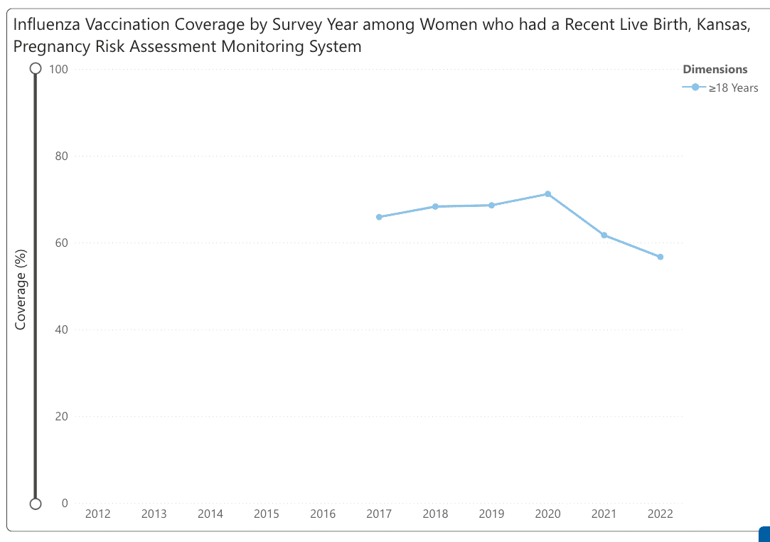
Kansas’ flu vaccination coverage fell from a high of 71.2% to 56.7% in the most recent season with available data (2022)
Reference: www.cdc.gov/fluvaxview/interactive/pregnant-women.html?CDC_AAref_Val=https://www.cdc.gov/flu/fluvaxview/interactive-pregnant-women.htm

Slide 36
Kansas’ flu vaccination coverage fell from a high of 71.2% to 56.7% in the most recent season with available data (2022)
Important Note:
During pregnancy is the ideal time to start talking with the mother about vaccinating the baby after delivery.

Slide 37
Lesson 4:
Start with a more effective recommendation.

Slide 38

Walk the walk
Make sure the entire staff is vaccinated. Make it easy, make it fun...a lot of sites make it mandatory. This is important to the function of the office (it's so hard to deal with staff absenteeism during flu season) and to patient safety. We certainly don't want to spread influenza to our patients and their families!
Also, it's very difficult for unvaccinated providers to effectively recommend the vaccine.

Slide 39

Making the flu vaccine recommendation:
When? Why? How?
Balancing considerations regarding the unpredictability of timing of onset of the influenza season and concerns that vaccine-induced immunity might wane over the course of a season, particularly for older adults, vaccination is recommended to be offered by the end of October.
For pregnant women: Give injectable flu vaccine soon after vaccine becomes available. ACOG, CDC, and ACIP recommend that pregnant women get vaccinated during any trimester of their pregnancy.
For nonpregnant adults: Early vaccination (in July and August) should be avoided unless there is concern that later vaccination might not be possible.
For children who need 2 doses*: Give the 1st dose as soon as possible after vaccine becomes available to allow the second dose (which must be administered ≥4 weeks later) to be received by the end of October.
*Which children need 2 doses?
Children aged 6 months through 8 years who have never received flu vaccine or who have not previously received a lifetime total of ≥2 doses.

Slide 40
Making the flu vaccine recommendation:
When? Why? How?
Why?
Studies show that people are more likely to get their flu vaccine if their provider recommends it to them
How?
CDC developed the SHARE model to help you make a strong vaccine recommendation and provide important info, so patients make informed vaccination decisions

Slide 41
What is the “SHARE” model?
Share
Highlight
Address
Remind
Explain
Based on years of research into vaccine motivators, CDC has developed a mnemonic device to help healthcare providers make a strong vaccine recommendation
We will now go over each step in SHARE.
Reference: CDC "Talking About Influenza Vaccination"

Slide 42

SHARE
SHARE the reasons why flu vaccine is right for the patient given his/her specific risk factors. (CDC recommends annual vaccination for everyone 6 months and older with any licensed, age-appropriate flu vaccine with no preference expressed for one vaccine over another.)
You may want to say something like this:
“The flu vaccine may protect you from getting and spreading flu. Importantly, the vaccine will reduce the risk of severe complications from influenza.”

Slide 43

SHARE
HIGHLIGHT positive experiences with flu vaccines (personal or in your practice), as appropriate, to reinforce the benefits and strengthen confidence in flu vaccination.
You may want to say something like this:
“The healthcare providers in our practice recommend getting an influenza vaccine each year because we have seen so many patients end up in the hospital because of flu.”

Slide 44

SHARE
ADDRESS patient questions and any concerns about flu vaccines (e.g., side effects, safety, vaccine effectiveness) in plain and understandable language.
To a patient who says, "I don't get the flu vaccine because it causes the flu," you may say something like this:
“A flu vaccine cannot cause flu infection. The most common side effects of flu vaccine are mild -- redness, swelling, soreness, or a low-grade fever. These go away in a few days.”

Slide 45
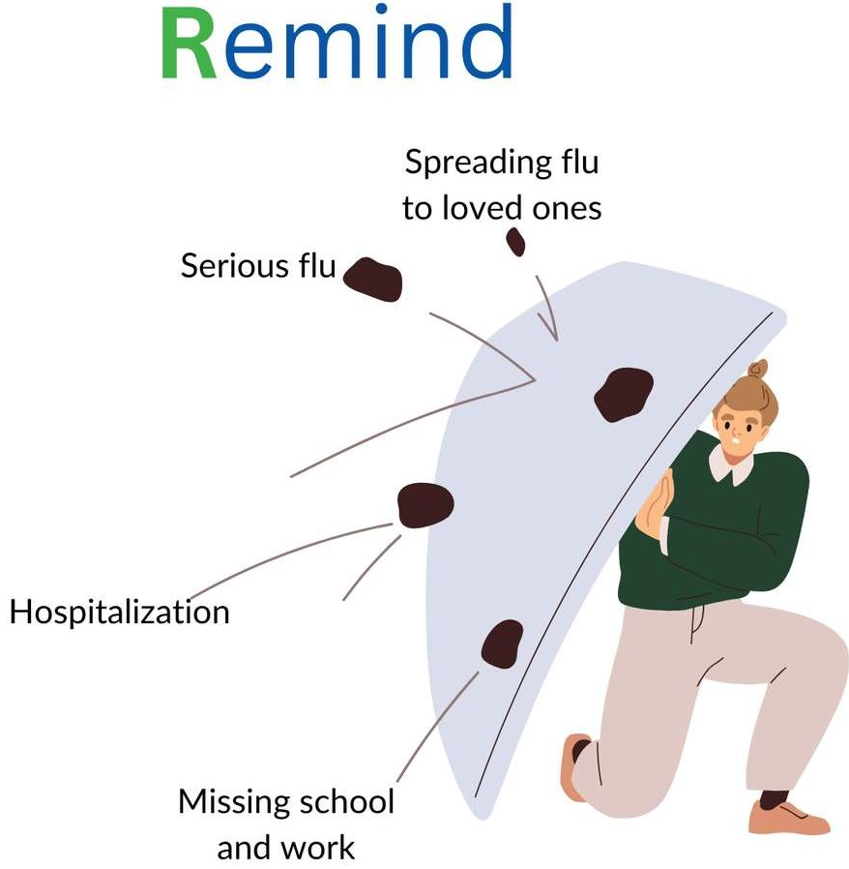
SHARE
REMIND patients that flu vaccines protect them and their loved ones from serious flu illness and flu-related complications. The vaccine takes 1-2 weeks to induce immunity so choosing to delay is leaving yourself open to INFECTION.
You may want to say something like this:
“Flu activity is going to start picking up soon, so I want to get you vaccinated now. The vaccine takes a week or two to kick in. I want to make sure I help protect you and your loved ones by vaccinating you before you're exposed.”

Slide 46

SHARE
EXPLAIN the potential costs of getting the flu, including serious health effects and time lost (such as missing work or family obligations).
You may want to say something like this:
“It’s important to get vaccinated because flu vaccination can reduce your risk of all the consequences of flu -- flu illness, doctor and emergency visits for flu, and missed work/school.”

Slide 47
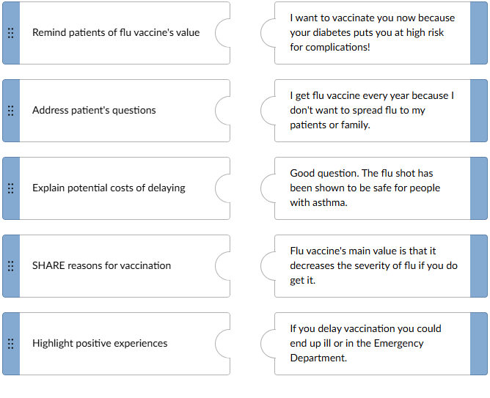
Test Your Knowledge!
Match each statement to a SHARE model step.

Slide 48
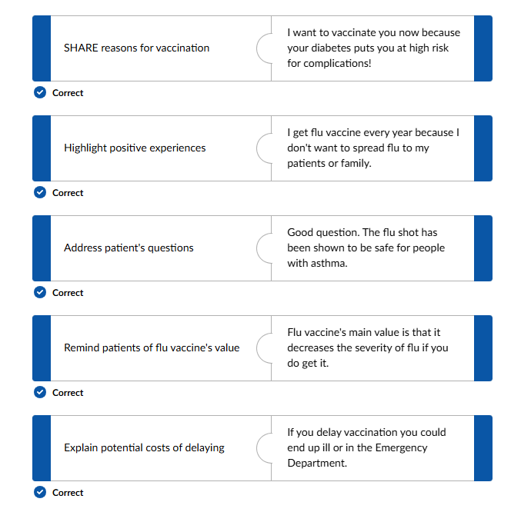

Test Your Knowledge!
Great work!

Slide 49

Reminders/Tips
A few last reminders about communicating with families about flu vaccine:
Keep it simple.
Balance statistics with personal stories.
Avoid repeating incorrect information.
Tie flu vaccination to protecting loved ones.
Position annual flu vaccination as an important component to overall management of health.

Slide 50
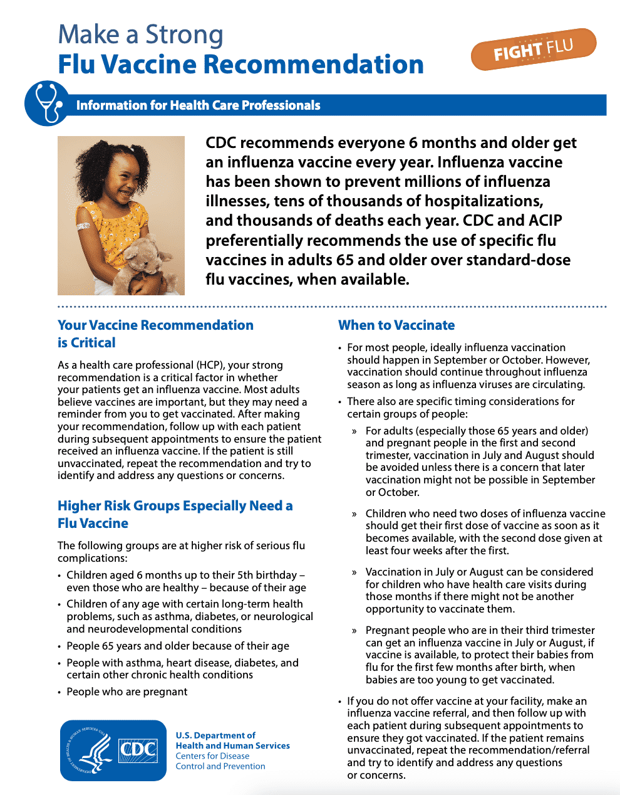
CDC’s “Make a Strong Flu Vaccine Recommendation” Flyer:
3-page general flyer
  For adults aged 50-60 years
  For adults 65 and older

Slide 51
Lesson 5:
Quick answers to common family and provider concerns

Slide 52
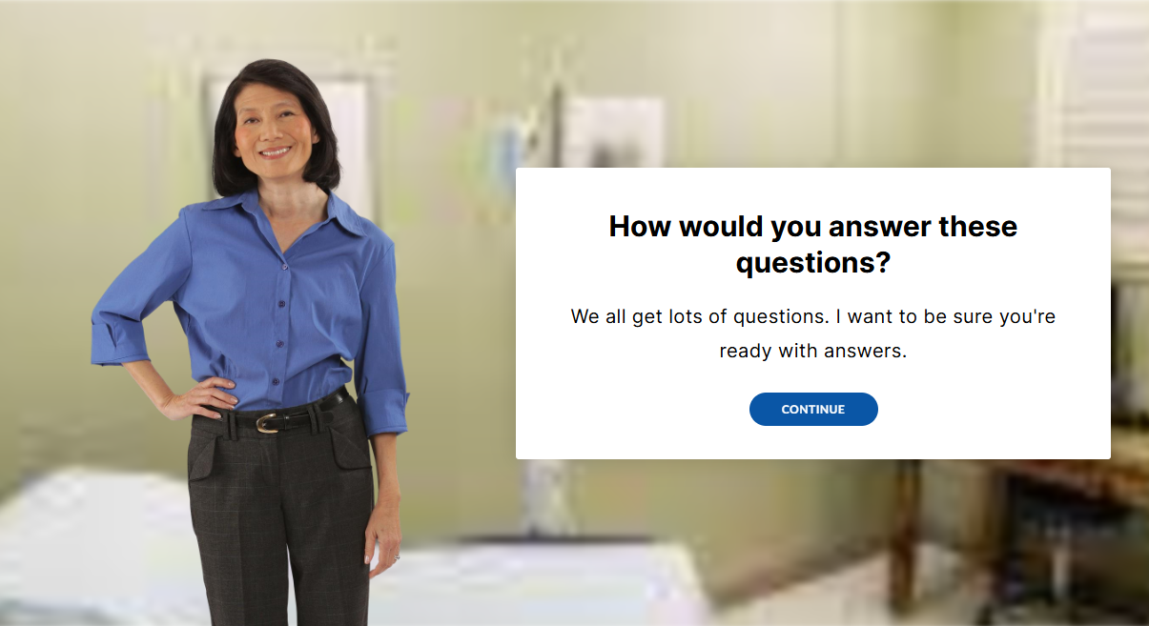

Slide 53
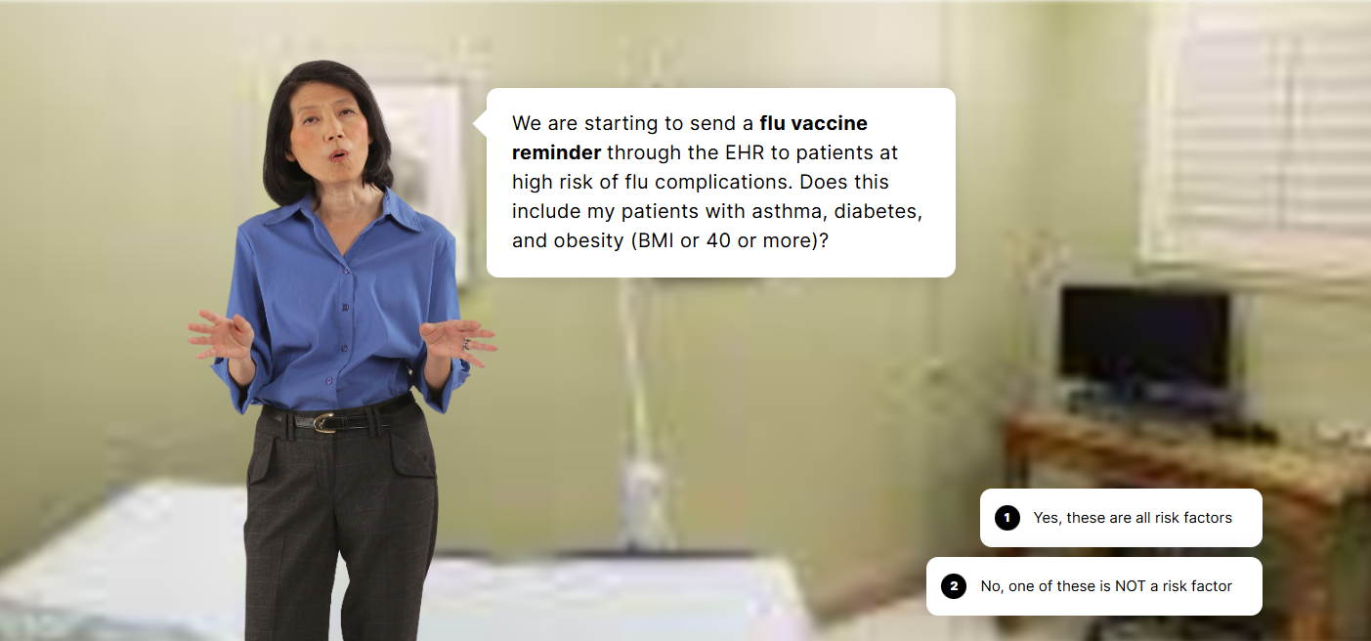

Slide 55


Slide 56
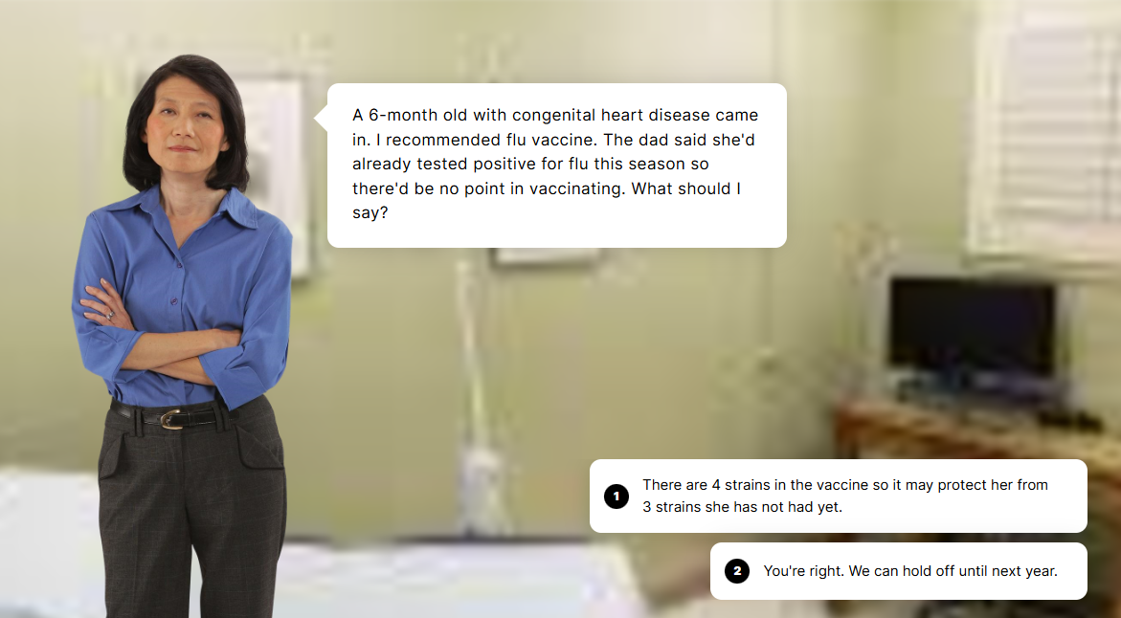

Slide 58
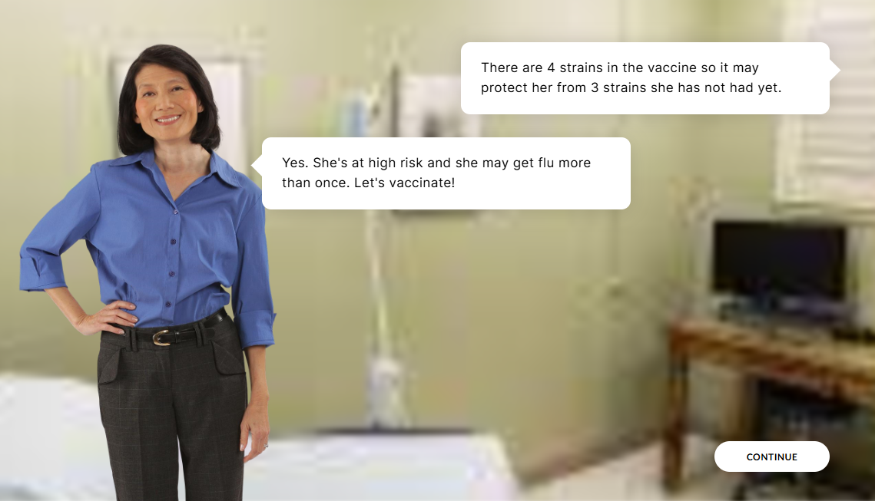

Slide 59
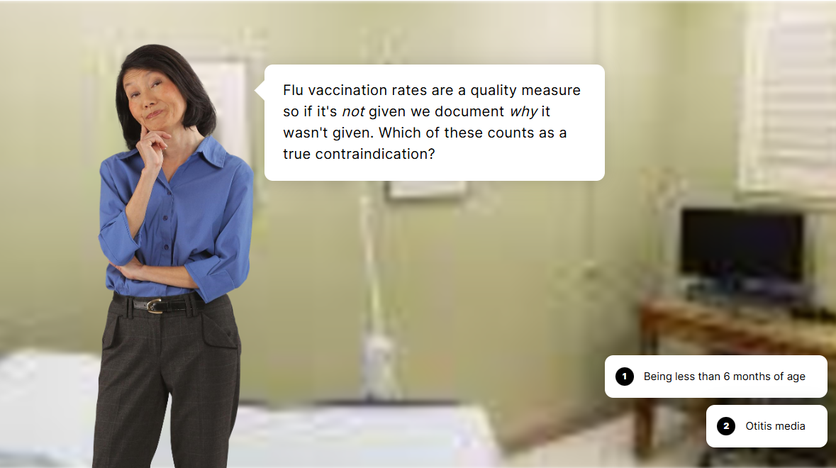

Slide 61


Slide 62
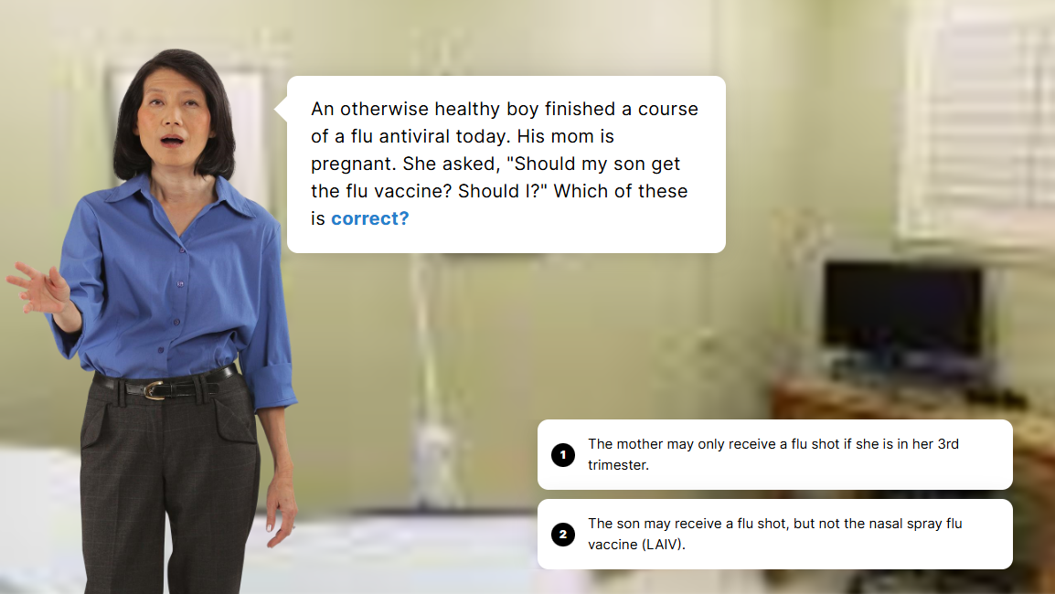

Slide 64
Scenario Complete!
Great Work!

Slide 65

“I’ve heard there’s a stronger flu vaccine.
Who should get that?”
ACIP recommendations for adults ages 65 years or older
ACIP recommends that adults aged ≥65 years preferentially receive any one of the following higher dose or adjuvanted quadrivalent influenza vaccines:
High-dose inactivated influenza vaccine (HD-IIV4)
Recombinant influenza vaccine (RIV4)
Adjuvanted inactivated influenza vaccine (aIIV4)
If none of these three vaccines is available at an opportunity for vaccine administration, then any other age-appropriate influenza vaccine should be used.
Other than this, ACIP does not state a preference for one influenza vaccine over another, although there are certain age and health condition restrictions.
For example:
Contraindications: LAIV should not be given, for example, to pregnant women or to those with severe allergic reaction (e.g., anaphylaxis) to any vaccine component excluding egg, anatomic or functional asplenia, or immunocompromise due to any cause. See Guide to Contraindications and Precautions to Commonly Used Vaccines.
Licensure: The recombinant vaccine (Flublok by Sanofi Pasteur) is only licensed for persons age 18 years and older.
Reference: https://www.cdc.gov/acip-recs/hcp/vaccine-specific/flu.html

Slide 66
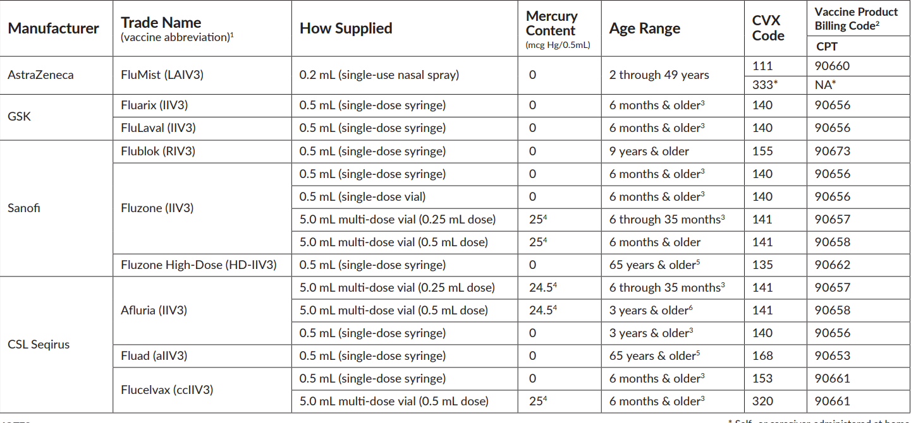
What influenza vaccines are available in the U.S.
Below is a link to a complete list of available influenza vaccines.
You can download it now at: www.immunize.org/catg.d/p4072.pdf
This list is updated each year. Check the date on the bottom right of the page to see when it was most recently updated.

Slide 67

“Should I vaccinate a patient with an egg allergy?”
People with an egg allergy may receive any vaccine (egg-based or non-egg based) that is otherwise appropriate for their age and health status.
Beginning with the 2023-2024 season, additional safety measures are no longer recommended for flu vaccination of people who are allergic to eggs beyond those recommended for receipt of any vaccine, regardless of the severity of previous reaction to egg.
All vaccines should be administered in settings in which personnel and equipment needed for rapid recognition and treatment of allergic reactions are available.
No post-vaccination observation period is recommended specifically for egg-allergic people. However, ACIP recommends that vaccine providers consider observing patients in a seated or supine position for 15 minutes after administration of any vaccine to decrease the risk for injury should syncope occur.
References:
https://www.cdc.gov/flu/prevent/egg-allergies.htm
https://www.cdc.gov/mmwr/volumes/71/rr/rr7101a1.htm

Slide 68
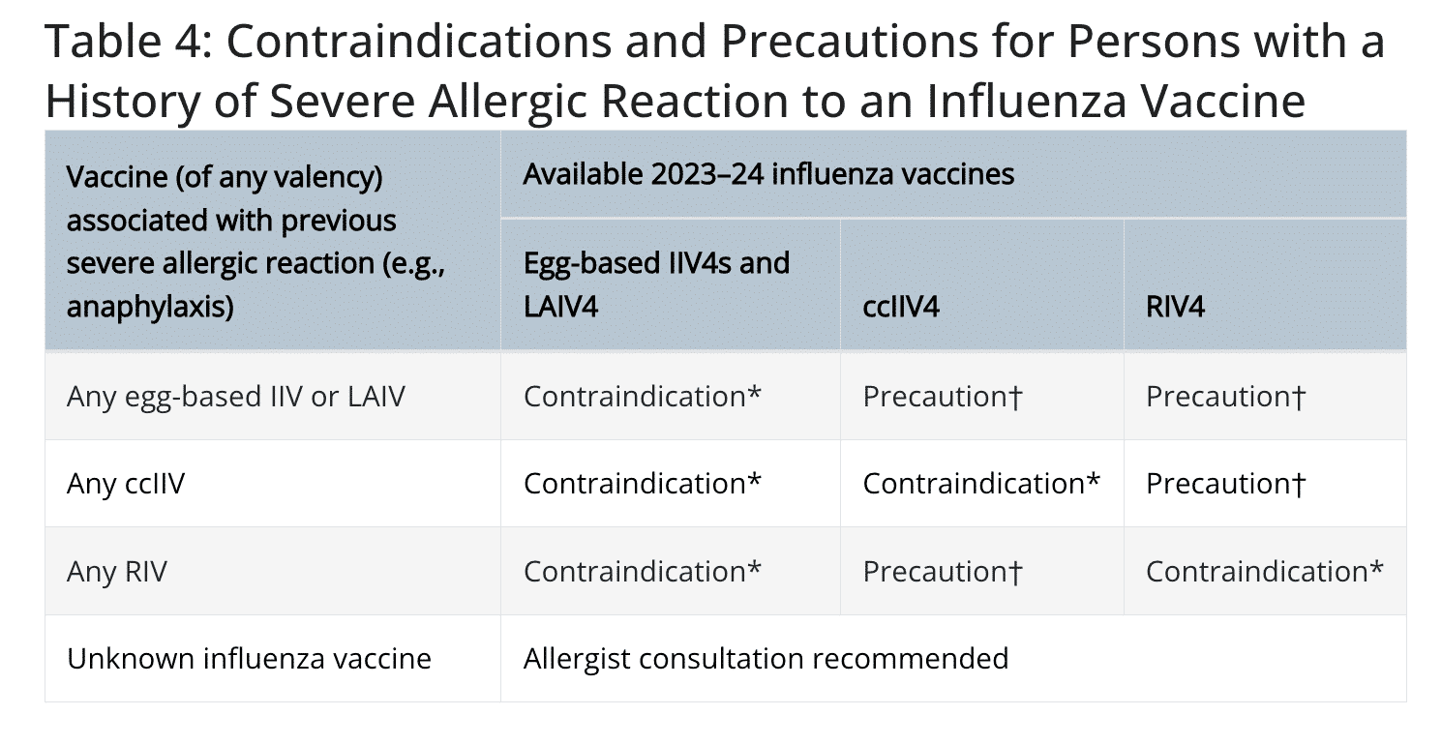
“Should I vaccinate a patient with severe allergic reaction to a previous flu vaccination?”
Reference: https://www.immunize.org/wp-content/uploads/catg.d/p3125.pdf

Slide 69
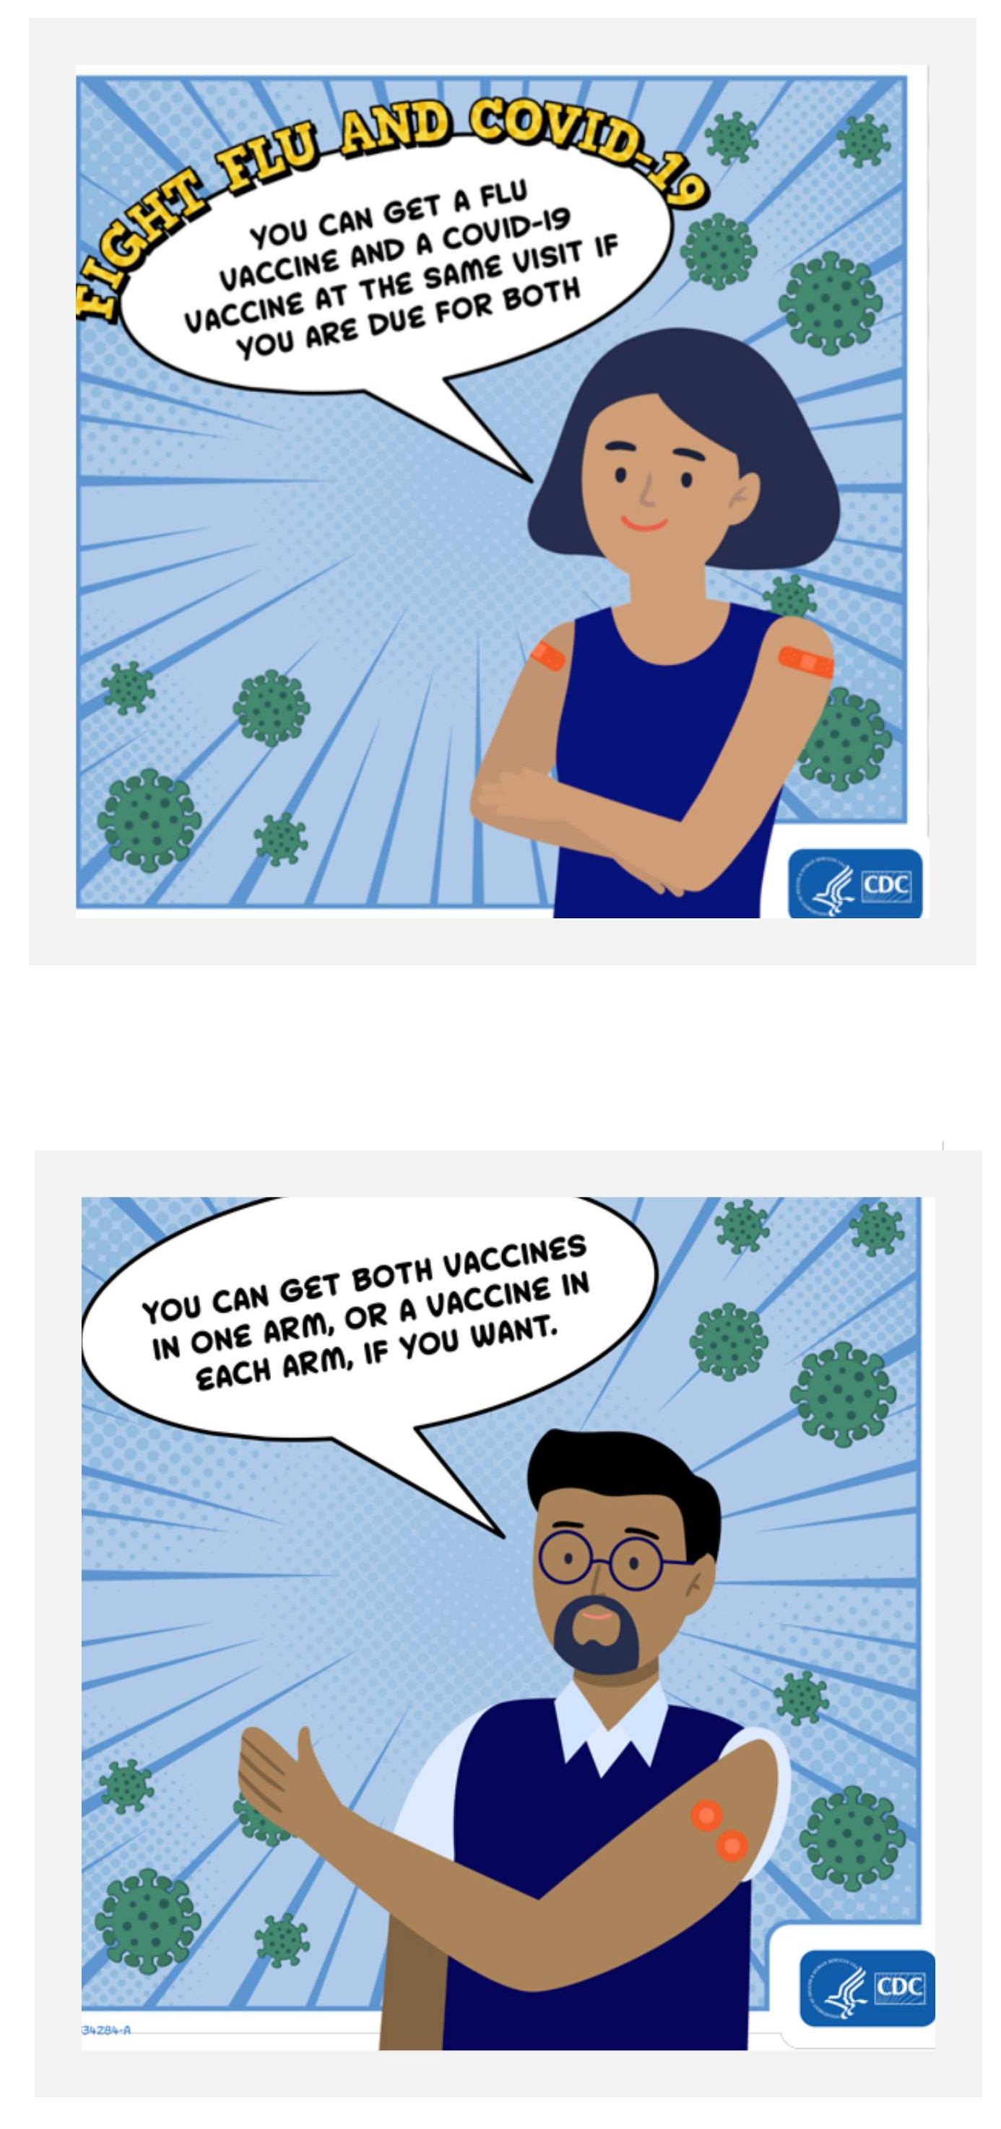
“Can I give a patient flu & COVID-19 vaccines at the same visit?”
At the same visit
Flu vaccines and COVID-19 vaccines can be given at the same visit if a person is due for both vaccines.
This might be more convenient than having two separate visits.
In the same arm
For flu and COVID-19 vaccines, you can either get both vaccines in the same arm (at least an inch apart), or you can get them in different arms. Either is okay.
The high-dose (Fluzone High-Dose Quadrivalent) or adjuvanted flu vaccine (Fluad Quadrivalent) may be more likely to cause side effects compared to standard dose flu vaccines. You may want to get these high-dose flu vaccines in different arms than the arm receiving a COVID-19 vaccine to reduce side effects in one arm.
For children, follow the American Academy of Pediatrics immunization schedule for influenza and COVID-19 vaccination recommendations.
For COVID-19 vaccine recommendations, it is wise to check for the most recent clinical considerations:
https://www.cdc.gov/vaccines/covid-19/clinical-considerations/covid-19-vaccines-us.html#Coadministration
References:
https://www.cdc.gov/flu/vaccines/coadministration.html

Slide 70
“Should I give flu vaccine to people who have been exposed to or are recovering from an infectious disease? What about COVID-19?”
According to Immunize.org's Ask the Experts:
“In general, neither exposure to or recovery from an infectious disease is a contraindication or precaution to vaccination. . . .
COVID-19 is the exception to this general rule. CDC recommends that routine vaccination should be deferred for persons with suspected or confirmed COVID-19, regardless of symptoms, until criteria have been met for them to discontinue isolation. The reason for this exception is that vaccination visits for these individuals should be postponed to avoid exposing healthcare personnel and other patients to the virus that causes COVID-19.”

Slide 71
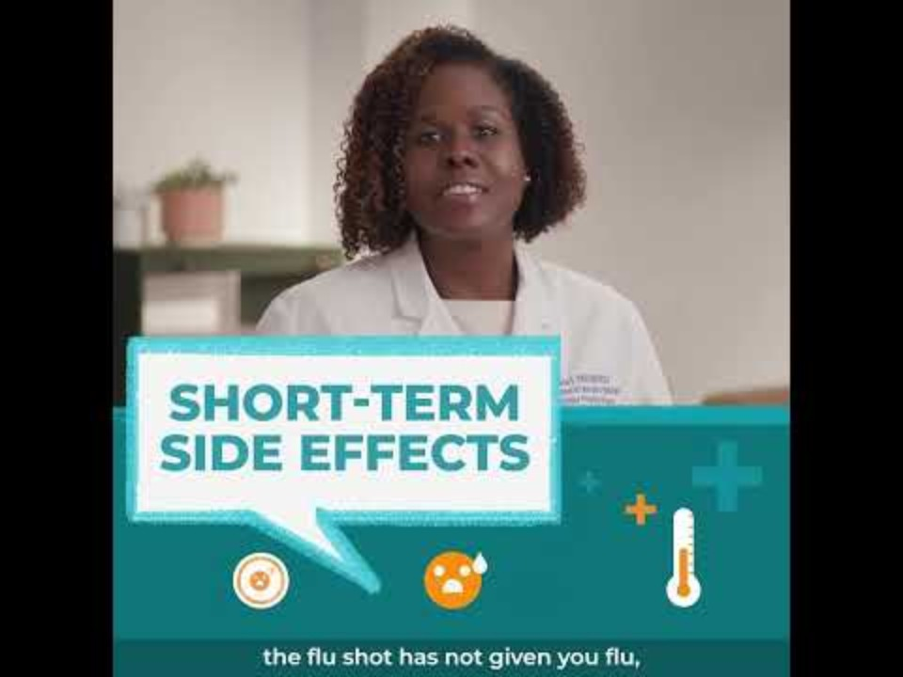
“Should I vaccinate a patient with a mild illness (other than COVID-19)?”
A mild acute illness (e.g., diarrhea or mild upper-respiratory tract infection) with or without fever is not a precaution, and vaccines may be given.
It’s wise to do this rather than lose them to follow up.
Top Eight Questions about the Flu Vaccine (3:24 minutes)
Reference: https://www.immunize.org/ask-experts/topic/contraindications-precautions/

Slide 72
Lesson 6:
Beyond communication: doing better!

Slide 73
Administrative Change Ideas
When you know your immunization rates and decide you want to improve, you need ideas about what to change.
In a formal quality improvement program, you may begin by mapping the current workflow to see where there are opportunities. Many offices use change ideas that have worked for others.
The following is just that...a brief list of change ideas that have helped other offices improve their flu vaccine coverage.
Make sure that everyone who works in the office is vaccinated. As healthcare professionals we must walk the walk.
Keep up to date on immunization recommendations by the Immunize.org, the American Academy of Pediatrics (AAP), and the American Academy of Family Physicians (AAFP) websites.
Use reminder or recall messages. For example, send email, call, or text reminders to all asthma patients to make an appointment before flu season. Call to follow-up missed appointments that would have included vaccination, especially with high-risk patients.

Slide 74
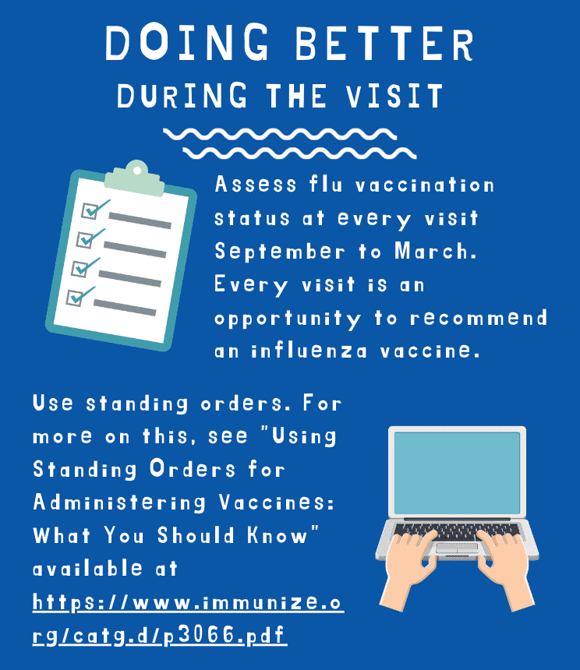
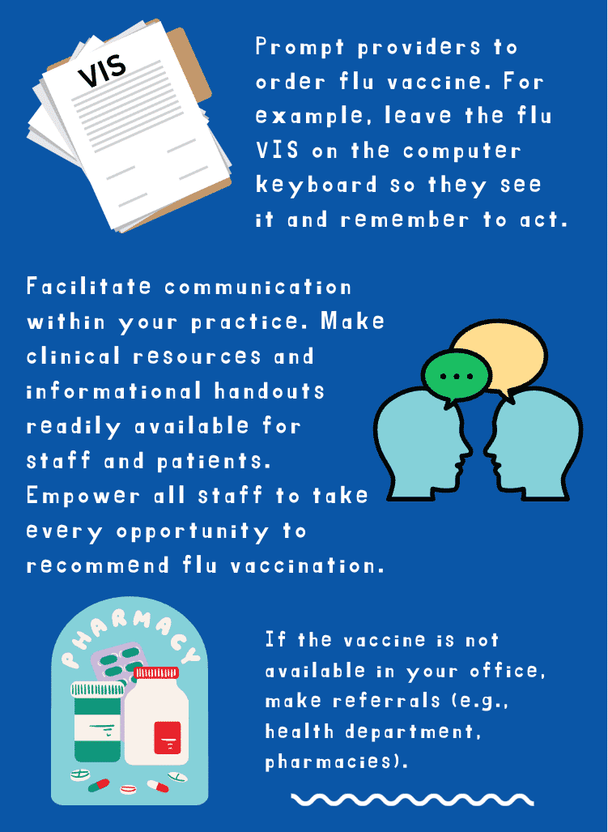

Slide 75
Standing Order Resources (from Immunize.Org)
Standing Orders Templates for Administering Vaccines Landing Page:
  https://www.immunize.org/standing-orders/
Influenza Vaccine Standing Order Templates (both were updated 9/14/2023)
“Influenza inactivated and live intranasal – adults”
  https://www.immunize.org/catg.d/p3074.pdf
“Influenza inactivated and live intranasal – children and teens”
  https://www.immunize.org/catg.d/p3074a.pdf(opens in a new tab)
How to Use Standing Orders
“Steps to implementing standing orders for immunization in your practice setting”
  https://www.immunize.org/catg.d/p3067.pdf
  Updated 6/12/23
“Influenza inactivated and live intranasal – adults”
  https://www.immunize.org/catg.d/p3066.pdf
  Updated 5/29/23

Slide 76
Lesson 7:
Wrap Up

Slide 77
Here are the key points:
1
Flu is a serious illness that takes a heavy toll on people in the U.S. every year.
2
Flu vaccine can prevent illness or at least make it less severe. It also prevents the spread of the disease.
In Kansas there’s room for improvement in flu vaccination rates in all age and risk groups, and especially for adults ages 18 to 64.
3
Making a strong recommendation and being prepared to answer questions succinctly helps office vaccination rates.
4
5
Use office-based strategies (e.g., patient reminders, standing orders, immunization rates assessment with feedback to clinicians).

Slide 78

Reminders/Tips
What steps will you take next?
Here are some ideas.
Start using the SHARE model and other tips you learned in this module
Share this module with others in your practice or use it to teach an in-service
Do a quality improvement project to boost your flu vaccination rates (you may want to start by focusing one age group) Using KS WebIZ data can help you track your progress

Slide 79

Congratulations!
You have finished this module.
Full list of resources used in the creation of this module:
Flu Immz Resources – Updated Sept 2025.docx
You can download the American College of Physicians’ “Vaccine-Catch-Up” template from their webpage, or by clicking the link below.
vaccine-catch-up-email-template.docx

Slide 80

If you are a healthcare provider and want CE credit...
IKC’s Preventing Flu education module is a 0.5-hour Continuing Education (CE) activity. CE is available at no cost to physicians, pharmacists, physician assistants, nurses, and nurse practitioners.
These slides contain the same content as the education module; however, you will need to complete the online education module to claim your CE credit.
To start the online education module, scan the QR code, or visit the link below:
https://rise.articulate.com/share/O7bkDu1VM4Xjx13lH1iPBbApoDQUi1dJ

Slide 81


#KansasFightsFlu
#KansasFightsFlu is a campaign to encourage healthcare providers and organizations to raise awareness on the importance of influenza immunization rates in our communities. The goal is to increase rates of influenza vaccinations across Kansas.
Visit IKC’s #KansasFights Flu page to for the latest flu resources, graphics, reels, and more!

